Slide 1
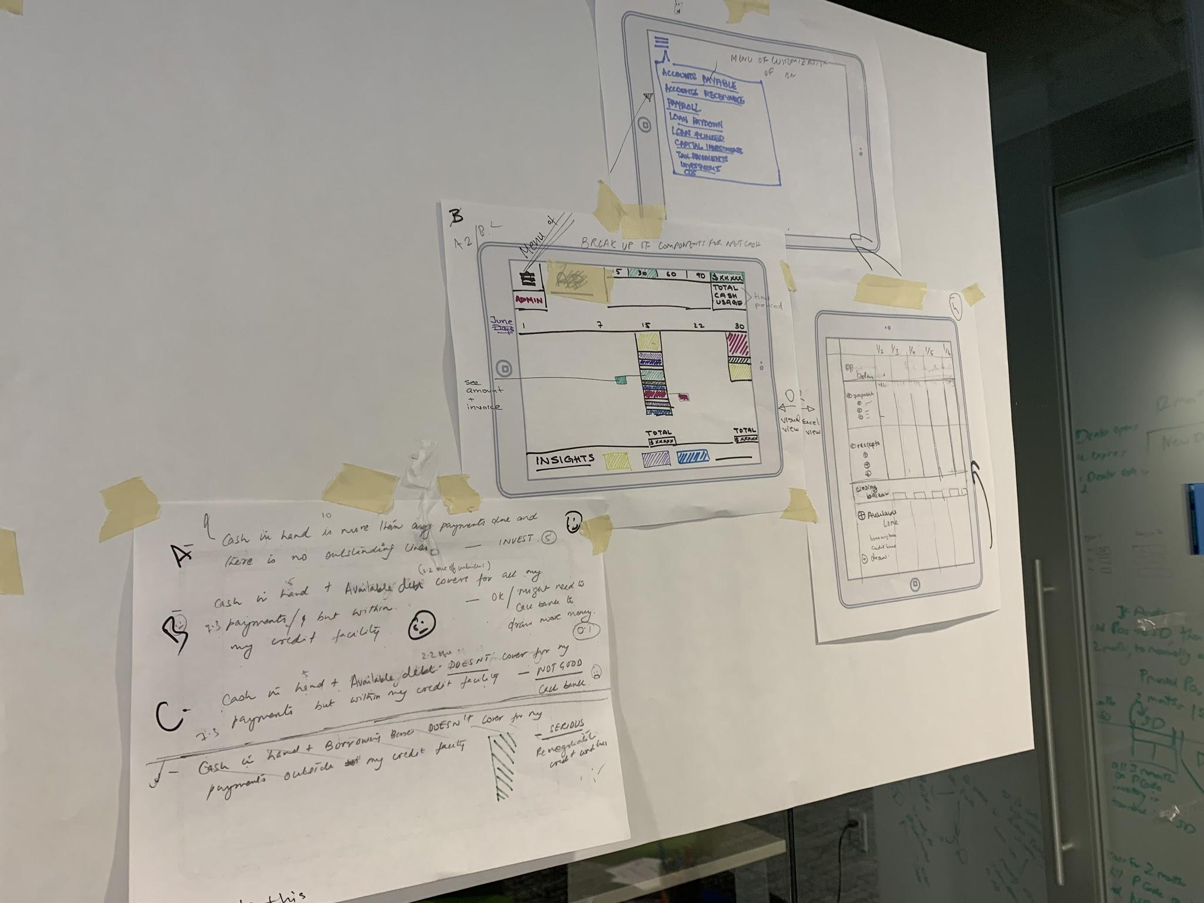

Girl Develop It!
Design Critique and Storytelling Pt. 1

Slide 2

Welcome!

Slide 3


MEET YOUR INSTRUCTOR
Rahel Campbell
Senior UX Designer @ Infosys/Wongdoody
3.5 years Experience

Slide 4
01
TODAY’S AGENDA
Design Critique
What/Why Design Critique?
Principles of Design Critique?
Examples of Design Critique
Storytelling
What/Why Storytelling?
Principles of Design Critique
Examples of Storytelling
Next Steps
Prep for part 2 - Next Steps
Design Critique and Storytelling Pt. 1

Slide 5

02
Design Critique
Design Critique and Storytelling Pt. 1

Slide 6
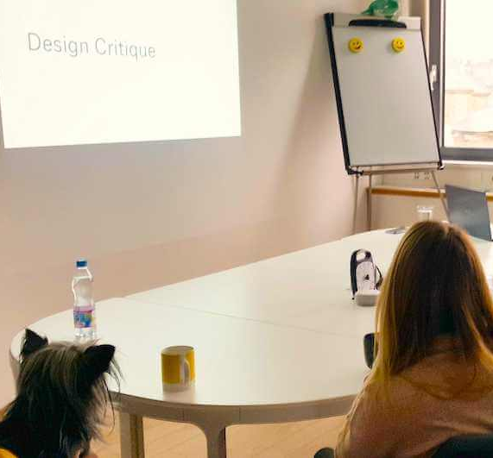
THE WHAT?
What is a Design Critique?
A design critique is performed in order to evaluate a design and provide feedback on whether or not it meets business objectives and user needs.
Design critiques encourage collaboration within teams and provide a boost to positive team culture toward improving design ideas.
The feedback received during design critiques helps designers think outside of the box, often leading to better, more innovative choices throughout the design process.
Conducting a productive design critique session can be challenging. Designers often forget that not everyone understands the finer points of the design process, the language of design criticism, and the rules of a design critique.

Slide 7

THE WHY?
Why Design Critique?
It is nearly impossible to improve a design without feedback from others. Their input helps you avoid mistakes and thus create higher quality work.
The old saying rings true: two brains (or more in this case) are always better than one.

Slide 8

THE WHY?
Reason #1:
A positive culture of critique supports team building in multiple ways. Sharing designs early allows for earlier buy-in from team members that otherwise may not feel confident about the work and builds team consensus.
Over time, this practice creates team trust and prevents any destructive egos from causing too much damage to a project.

Slide 9

THE WHY?
Reason #2:
Second, design critiques enable cooperation and collaboration across teams. Your work can influence the work of others.
For example, developers could build more extensible code throughout the current release if they have an understanding for what designs may come in the future. In this same way, they could question technical feasibility when the designs are still in progress and can be changed without throwing time and money away.
Multiple designers who work on different parts of a big project can pick up possible inconsistencies across the overall user experience when they all participate in early critiques of each other’s draft designs.

Slide 10

PRINCIPLES
5 Principles for Effective Design Critiques:
Principle #1
Clear scope for the conversation. Too often critiques become unwieldy due to lack of scope. Critiques will only prove beneficial if there are unambiguous boundaries for what can and should be critiqued. Once boundaries are set, participants, duration, and formality can be determined.
What to Bring: Have a clear objective, agenda, and time frame outlined.
Questions to Consider:
1. What’s the project?
2. Who are we designing for?
3. Main concerns and user questions
4. What’s the rationale behind the solution?
5. What is our goal?

Slide 11

PRINCIPLES
5 Principles for Effective Design Critiques:
Principle #2
Agreed-upon design objectives for the work. In order to analyze a design and whether it meets its goals, there must be agreement on the problem that needs to be solved. This likely means a clear understanding of users and their needs. Without these, any feedback is subjective and baseless.
What to Bring: Have the materials/artifacts that informed your design decisions making:

Slide 12

PRINCIPLES
5 Principles for Effective Design Critiques:
Principle #3
Conversation rather than command. Commands, or directives, can very quickly ruin the exact purpose of the critique, which is to foster open discussion in order to improve the outcome..
What to Bring: Have a clear objective, agenda, and time frame outlined. Have the materials that informed your design decisions making:

Slide 13

PRINCIPLES
5 Principles for Effective Design Critiques:
Principle #4
Asking the right questions. The role of the facilitator is to ask pressing questions to ensure that the presenter is getting the right feedback. The facilitator can reformulate questions or comments that sound opinionated (“This is too red!”) or directive (“I would have done it differently!”) to relate them to the goals of the design.
What to Bring: Have a partner who can help facilitate feedback and staying on track ensuring feedback is productive and focused on the key objectives.

Slide 14
PRINCIPLES
5 Principles for Effective Design Critiques:
Principle #5
Documenting the discussion. A facilitator may also act as a recorder. In some cases, someone else on the team can adopt this role. The recorder should take notes publicly, using a collaborative editing tool, and should allow all participants to add additional observations and clarification in real time.
What to Bring: Use spreadsheets, and outline key takeaways from feedback so you can incorporate when you return to design.

Slide 15
EXAMPLES
Examples
Bad question: Yikes… that layout!
Reformulation: How does this layout make it easier for the user to accomplish their task quickly and efficiently?
Bad feedback: I love those colors, but I think that button is in the wrong spot and the overall page looks busy.
Reformulation: If the goal is to have the user register quickly, I’m concerned we are placing emphasis on the wrong elements and hiding the primary task by making the button hard to find.

Slide 16
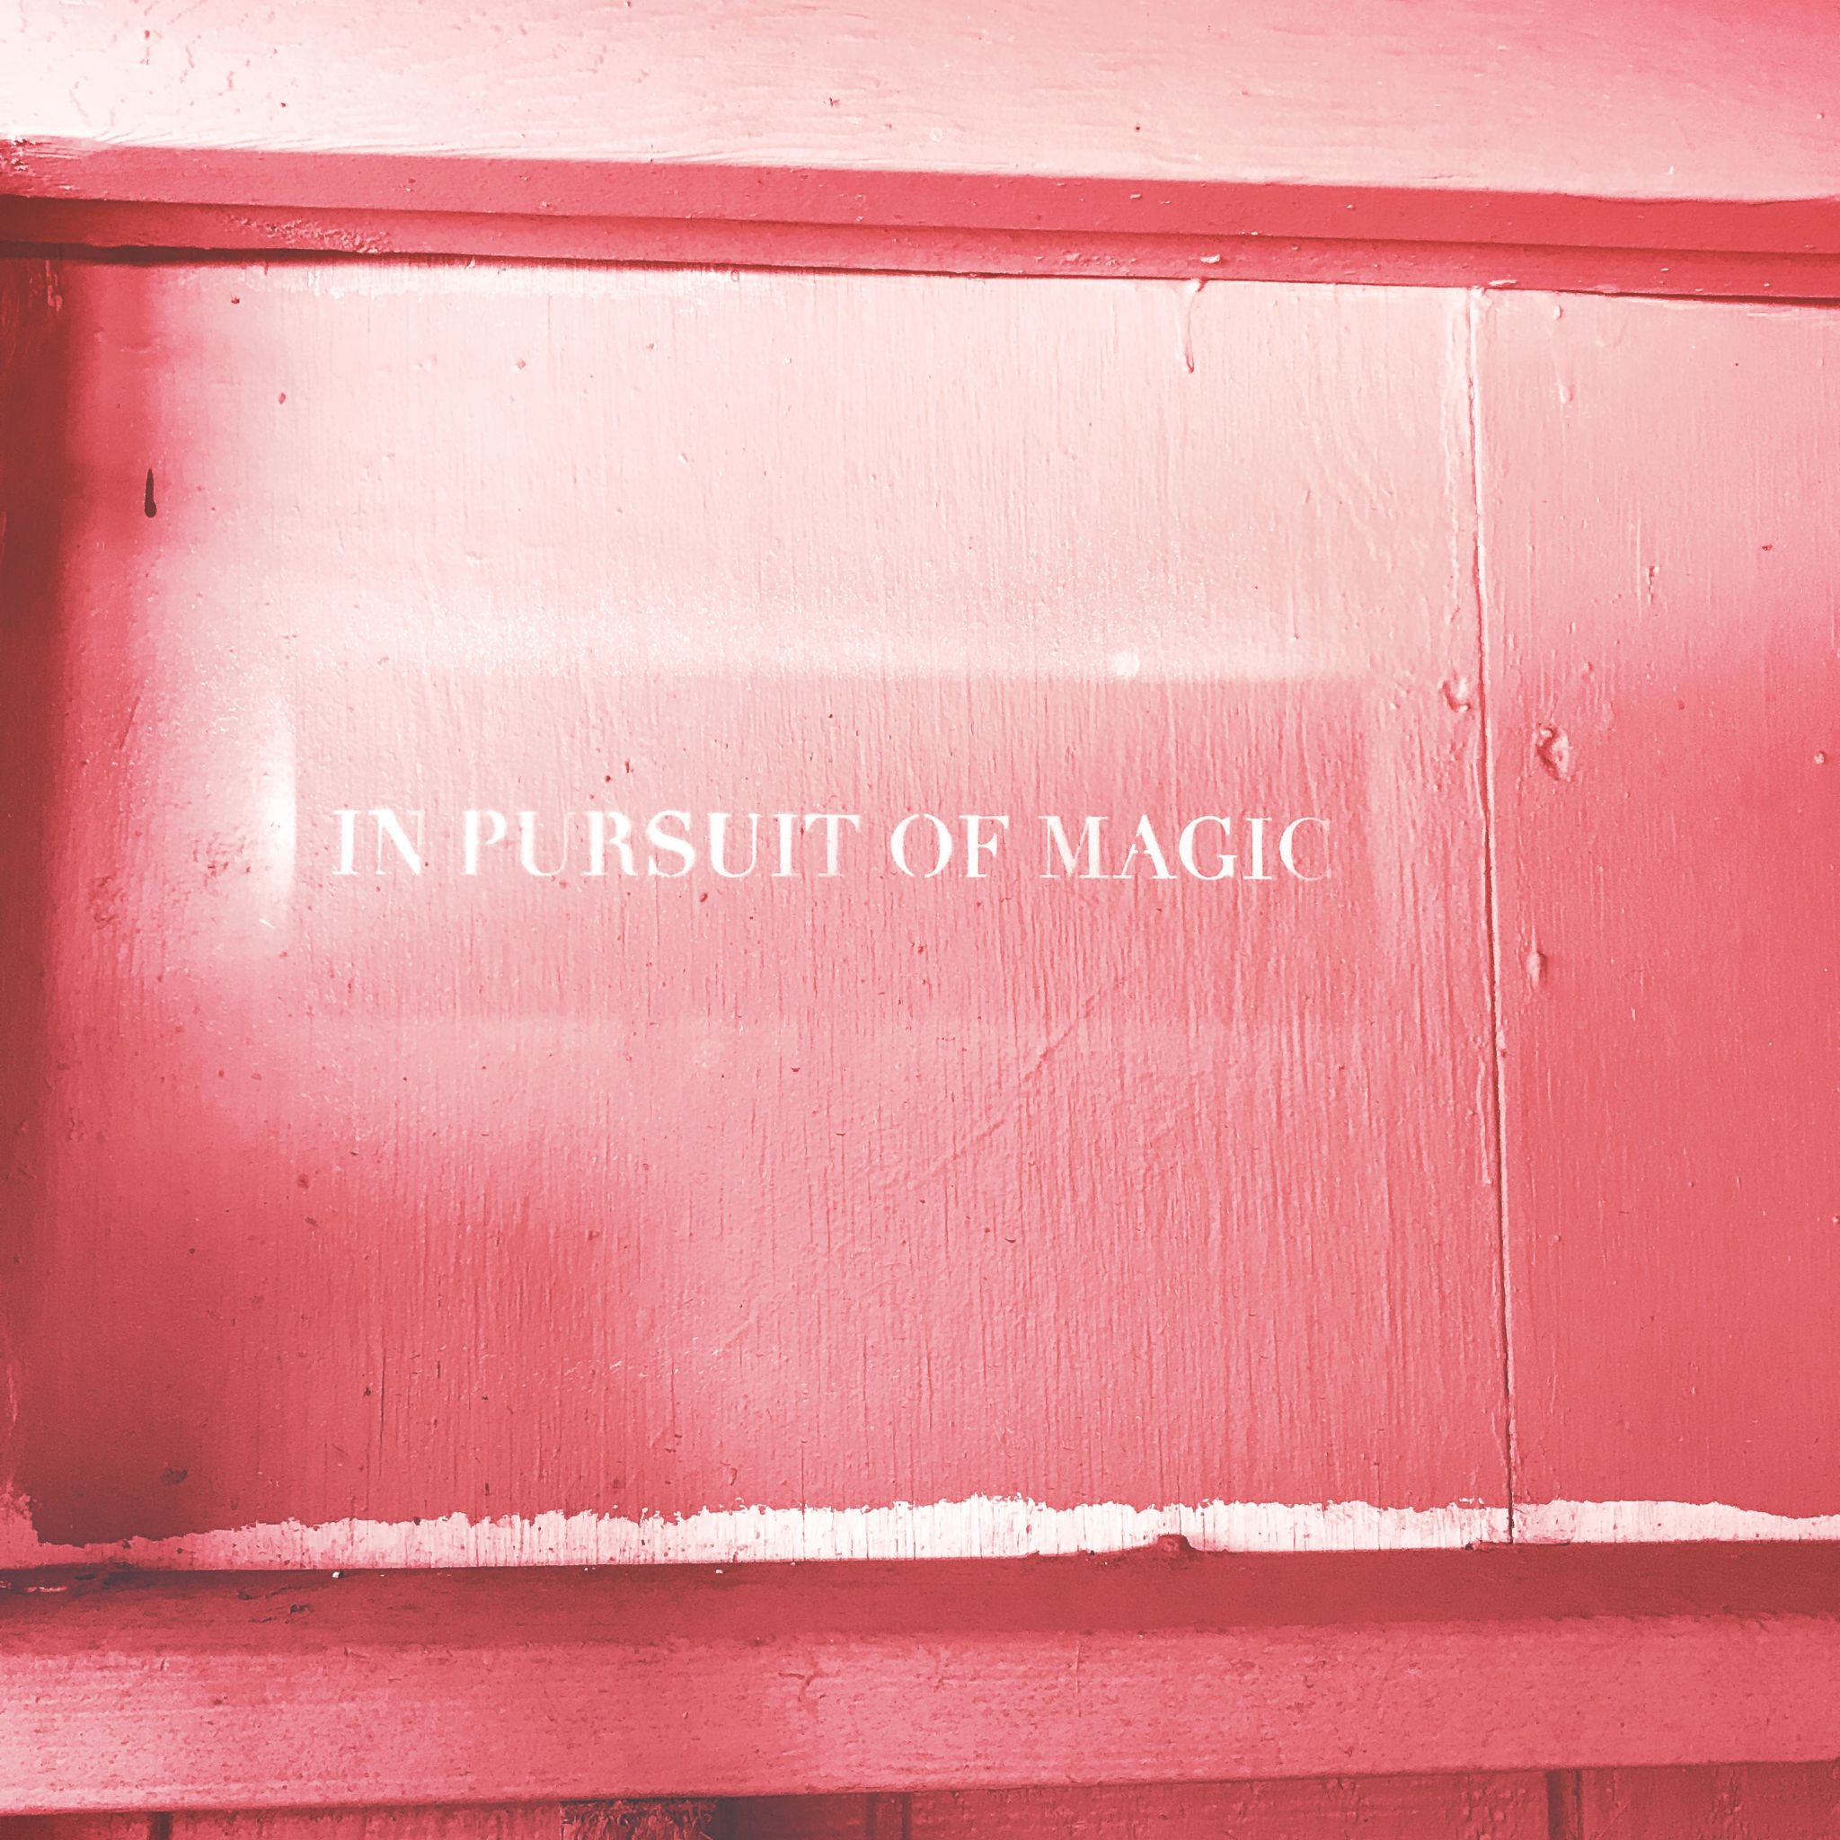
ACTIVITY
Activity Time: Your Turn!
Bad feedback: If I were you, I would change the the layout because it’s confusing
Bad feedback: I think overall the button is in the wrong spot and it looks confusing
Bad feedback: I don’t like the color choice you used.
How would you reformulate this feedback? Take a few minutes to think through each feedback example, then we’ll share our thoughts.

Slide 17

02
Storytelling
Design Critique and Storytelling Pt. 1

Slide 18

WHAT?
What is Storytelling?
Storytelling is a method of delivering highly retainable information through immersion, allowing us to have an experience without experiencing something directly ourselves.
Much of this is due to the fact that our brains are hardwired for story. We naturally process the past and the present through narrative based memories.
Storytelling is a communication tool used throughout all cultures, starting with the advent of campfires and stone tools, where we first used stories to exchange information in order to warn, teach, and inspire within our earliest communities.
When do you use storytelling? Can you think of time storytelling made a difference for you?

Slide 19

WHY?
Why Storytelling?
Designers create personas to represent target users and add conflict to stories that reflect their user journeys and problems. Crafting stories, designers can better understand what users want from a solution.
What’s the essential thing you are trying to convey to your audience? When you walk into a client meeting, what do you want them to take away the most? You aren’t selling them on a website, or a branding campaign. You’re selling them on a story, an idea, a dream.
Your client dreams of something bigger than just “website” or “brand.” They dream of loyal customers who say glowing things about them. They dream of changing the world through the work they do. They dream of some story that, as the designer, it’s your job to uncover.

Slide 20

PRINCIPLES
5 Principles for Effective Design Storytelling:
A reason
Be clear and understand the higher purpose of why you are doing what you are doing. What do you, your product, your service or your brand stand for? The WHY is always a good point to start. When you create a UX persona, for example, you want to define what the represented human being aims for in life. In an Experience Mapping, you first want to know why you are doing it!

Slide 21
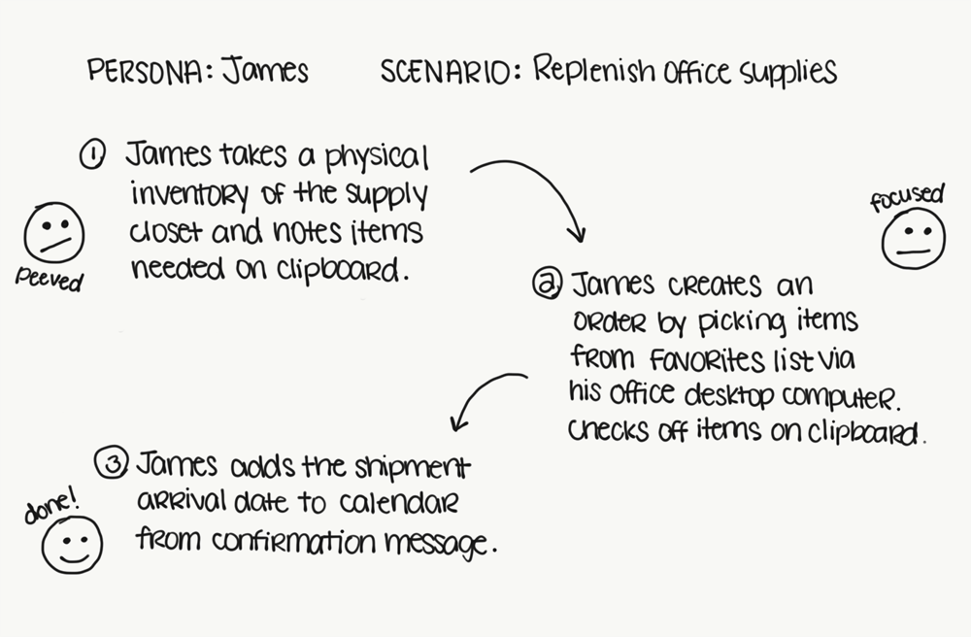
PRINCIPLES
5 Principles for Effective Design Storytelling:
Main character
Every story needs a hero. You, your product, service or brand are NOT the hero. Your users, customers or the human beings you serve are. You are the enabler, the helper, the sidekick. You are the Alfred to Batman and not the other way around. Your are here to serve and help your user achieve a goal, even if it is only about creating joy and pleasure!

Slide 22

PRINCIPLES
5 Principles for Effective Design Storytelling:
Start with a conflict
In an ideal world, you want to solve someone’s problem or tackle a challenge. Conflicts are where a lot of good stories start. UX Design is about resolving conflicts your user deals with. Thus, you start with a good understanding of your user and a user’s pain points!

Slide 23

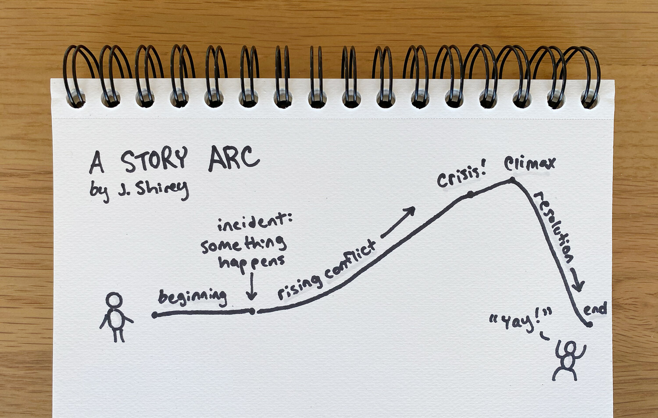
PRINCIPLES
5 Principles for Effective Design Storytelling:
Structure
There are different ways of structuring stories. One that has proved to be successful is the three-act. Simply put, there are a start, a middle part and an end to such a story. This structure aligns nicely with a typical customer journey or life-cycle. It can be a used as an overarching structure of an UX journey mapping: Recruitment (User acquisition), Retention (Use of your product or service), Recovery (end of usage, ideally renewal and advocacy).

Slide 24

PRINCIPLES
5 Principles for Effective Design Storytelling:
Creation of awareness
Creating awareness in stories is about triggering emotional reactions. Joy 😀, surprise 😯, sadness 😔, anger 😡, fear 😱, disgust 😖. Unless you design the scariest rollercoaster experience, you probably want to relieve your user for a negative emotion and aim for joy in most cases.

Slide 25
PRINCIPLES
5 Principles for Effective Design Storytelling:
Resolution
What happened after you tested your design? Did you solve a problem? DId you learn anything new? Anything surprising? Tell us how things ended or where you are now and what you plan on doing next

Slide 26

KEEP IN MIND
Other Things to Keep in Mind:
Adapt your vocabulary to match your audience.
Appeal to the needs of your audience.
Back-up your points with real data.
Pair your story with an artifact for memorability and alignment.
Follow up with a summary.

Slide 27

EXAMPLE
Effective Times for Storytelling:
Design Critique -
Start the critique by telling your work’s story. Though this might feel silly, not only is it good practice for storytelling to customers, but it loops your audience into the problems you encountered and into your inspirations and decision points

Slide 28

EXAMPLE
Effective Times for Storytelling:
Your Portfolio -
The most effective UX-portfolio presentations have one thing in common: the candidate told a story. The processes you use to arrive at your final design solutions are likely messy and, at times, even chaotic. Do not censor those moments of reality. Embrace them. Use them to build a story.The processes you use to arrive at your final design solutions are likely messy and, at times, even chaotic. Do not censor those moments of reality. Embrace them. Use them to build a story.

Slide 29
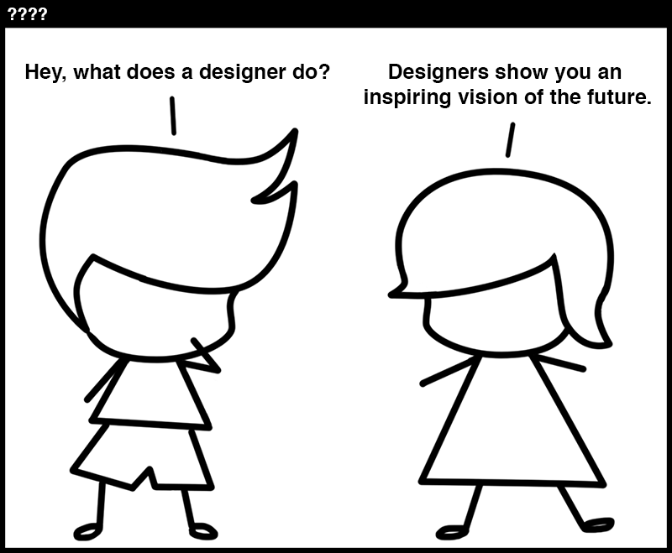
ACTIVITY
Effective Times for Storytelling:
Presenting your research + design to clients/stakeholders.
Can you think of any other instances when storytelling can help you in your role as a designer?

Slide 30
03
What to Expect
Design Critique and Storytelling Pt. 2

Slide 31

NEXT STEPS
Here’s what we’ve covered so far in the cohort:
User Research and Testing
Low-to-high prototyping in Figma
Research Synthesis

Slide 32
NEXT STEPS
Here’s what we’re asking students to present:
Brief introduction to problem statement
An overview of your insights
An overview of your solutions
1-2 examples of lessons learned
1-2 examples of recommended next steps

Slide 33
NEXT STEPS
Here’s what we’re asking students to present:
Brief introduction to problem statement
What is the problem and who is the targeted audience member(s).

Slide 34
NEXT STEPS
Here’s what we’re asking students to present:
An overview of your insights
Provide a snapshot of the insights you gathered during research and testing. What did you learn from your participants? What were the top 2-3 themes? Pay close attention to how these insights provided direction for your designs and why.

Slide 35
NEXT STEPS
Here’s what we’re asking students to present:
An overview of your solution
Your designed solution from low-to-high fidelity. An example is two to three images aligned next to each other to show how you went from low-fidelity to high-fidelity design. Reiterate how any insights played a role in the updates of your designs.

Slide 36
NEXT STEPS
Here’s what we’re asking students to present:
1-2 examples of lessons learned
What did you learn during this research and design process? What surprised you? What were the challenges and pain points you endured, if any?

Slide 37
NEXT STEPS
Here’s what we’re asking students to present:
1-2 examples of recommended next steps
If you had additional time to work on this project, what would be your top priority? Why would this be your first priority? How would you tackle this priority/go about completing it?

Slide 38
NEXT STEPS
Logistics:
Each student will have ~5 minutes to present to the class. Presentations are not required but strongly encouraged to receive the benefits of practicing design and critique
Present with 5-7 slides in a format of your choice (Google Slides, PowerPoint, Keynote, etc.) and be prepared to screenshare
As each student is presenting, we ask that others take notes of effective feedback per student/presentation and be ready to share
Remember - this is a safe space!

Slide 39

THANK YOU
Any Questions?
What did you learn new today?
See you next Monday 07/12 at 6pm ET!

